Slide 1
TEAM TITLE : BOT WITH SUIT
SUIT FOR DIGNIFIED LOOK,
BOT FOR DIGNIFIED WORK

Slide 2
REASON FOR THE TITLE
The Magical work can be done by the bots. We feel this, When we just see the output of it. Once we put our head into the Logic, We come to know that how Dignified work can be done by the Bots to Save our time. This is Really Impressive, Bots make us to step Higher than our normally reach. That’s the reason BOTS ARE SUITS FOR OUR WORKS and bots working process inspired me a lot.

Slide 3
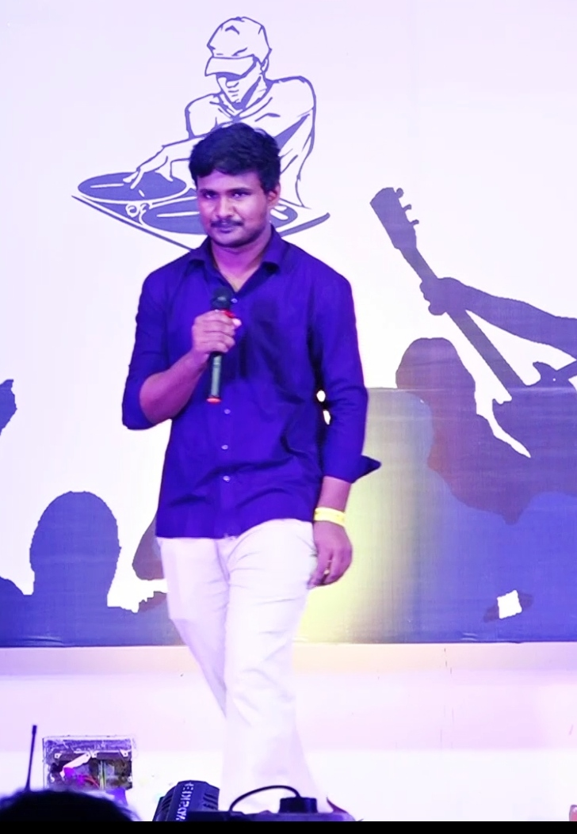
NAME: MACHIREDDY SAI PAVAN KUMAR
COLLEGE: SAGI RAMAKRISHNAM RAJU ENGINEERING
COLLEGE, BHIMAVARAM.
PURSUING : BTECH(4/4 CSE)
PASSION : DATA SCIENCE
Dream Company: TCS
HOBBIES : Mimicry, Social Networking, Acting,
Listening to ethical stories.

Slide 4
INTERNSHIPS:
1. Data Analytics at Shaadi Times, Virtual (1 month)
Description: “ Impact of air Pollution on our life”: Tableau.
2. Data Science & Analytics at The Sparks Foundation, Virtual (1 month)
Description: Tasks on Machine Learning Supervised Learning.
Student marks prediction.
PROJECTS:
1. Title: COVID-19 DASHBOARD (LIVE) : Tableau
2. Title: IMPACT OF AIR POLLUTION ON OUR LIVES: Tableau
3. Title: COVID-19 PREDICTING PROBABILITY : Python, Machine Learning
4. Title: TWITTER SENTIMENT ANALYSIS : Python, Machine Learning, NLP
5. Title: LOCAL-WORKERS Technologies: Net beans, Java

Slide 5
DELIVERY TRACKER
PROJECT TITLE

Slide 6
PROBLEM STATEMENT
To Capture all the Actual Delivery date which is the proof of delivery(POD) for all tracking numbers from different tracking carriers from the input.

Slide 7
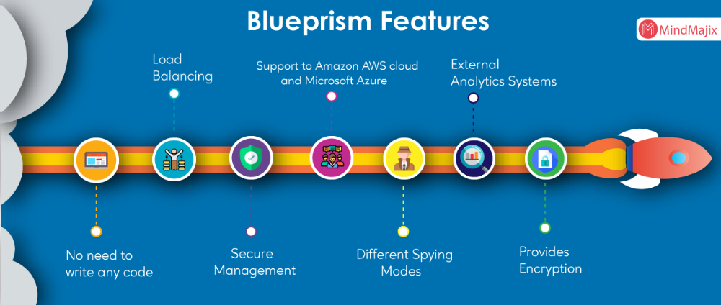

Slide 8
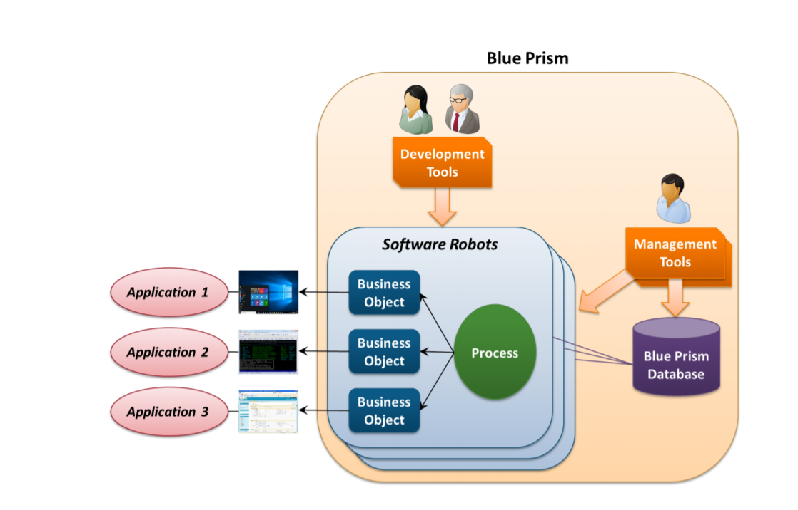

Slide 9




CARRIERS

Slide 10
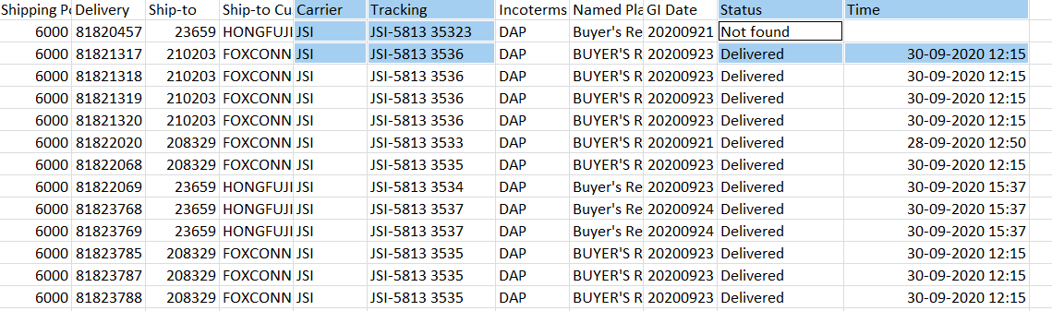
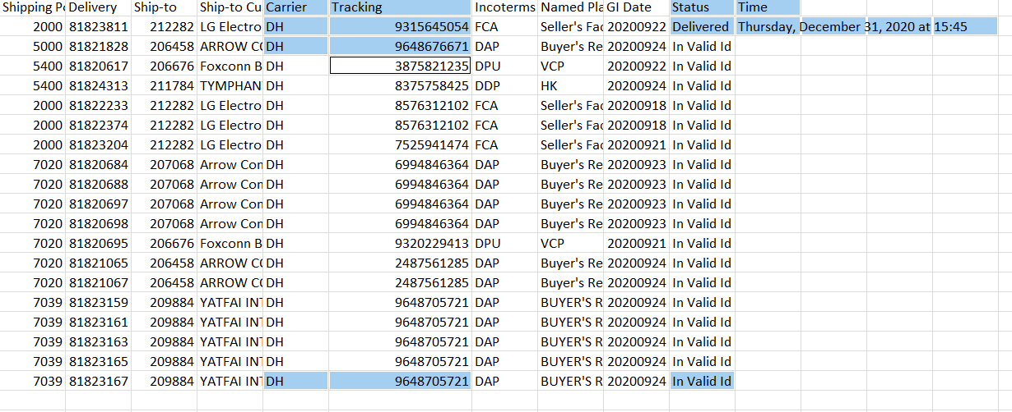
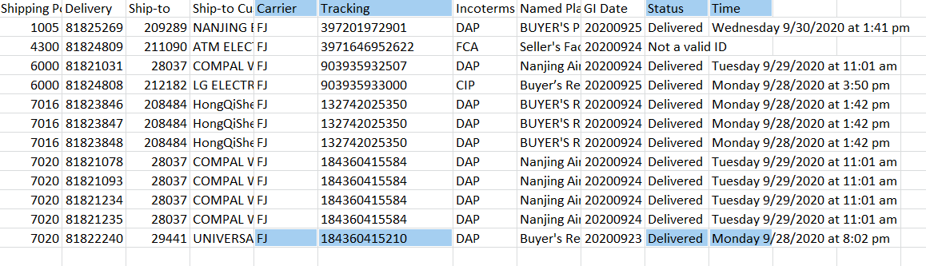
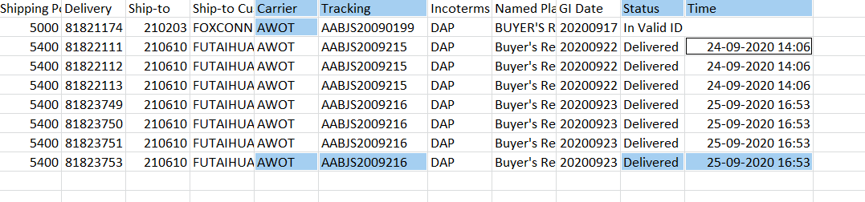
JSI(Omni logistics)
DHL
AWOT
FEDEX

Slide 11


